Slide 1




SOCIAL MEDIA AND MENTAL HEALTH ANALYSIS
Submitted by- Sneh Raj

Slide 2
ABOUT THE DATASET
This dataset contains various information regarding to the Social Media they use like Facebook, Instagram, Snapchat, TikTok, Pinterest etc. It also includes various aspects of Mental Health Analysis like Lack of Concentration, Distraction, Sleep issues, Lack of Interests, Feeling of Depression, Seeking Validation from Others, Comparing with others etc. This Dataset has total 481 entries i.e. Sample Size is 481.
Source of Dataset - Kaggle

Slide 3
PROJECT OBJECTIVE
The main objective of this project is to analyze the Dataset and draw impactful insights in the role of Social Media on Mental Health of its users. Various aspects of which including distractions, restlessness, sleep issues, fluctuation of interests, comparison with others, difficulty in concentrations etc.

Slide 4
STEPS INVOLVED
1.
Data Cleaning - This step involves Handling Missing values, Removing Duplicates and Removing Unwanted Columns.
2.
Data Analysis and Visualization - This step involves performing Analysis along with preparing different charts for visualization.
Tools Used - Python, Pandas, Excel.

Slide 5
PROBLEMS
1.
Effect of Time Spent on Social Media on Mental Health.
2.
Effect of Social Media on Different Age Groups.

Slide 6
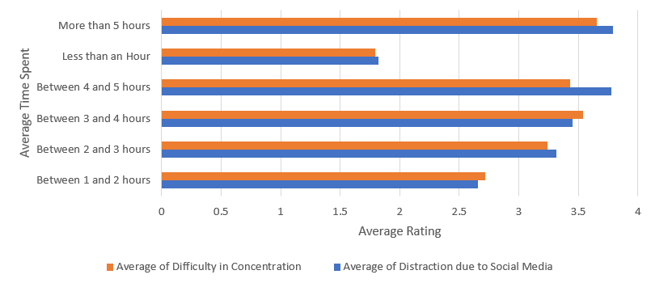
PROBLEM 1

Slide 7
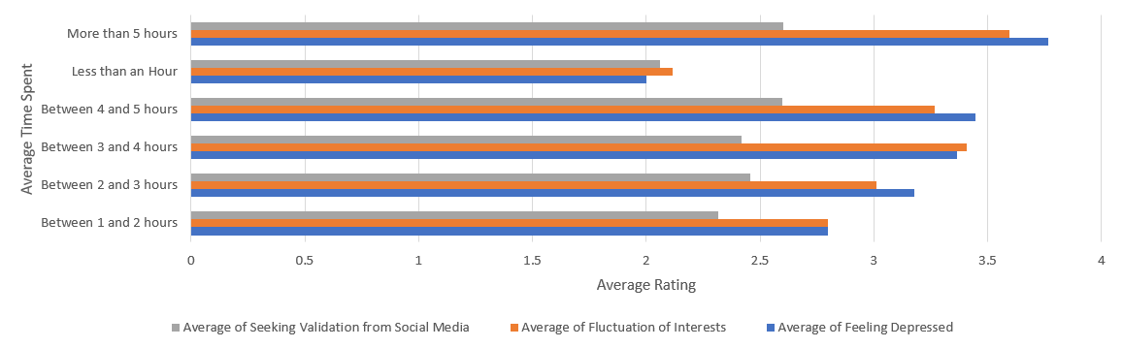
PROBLEM 1

Slide 8
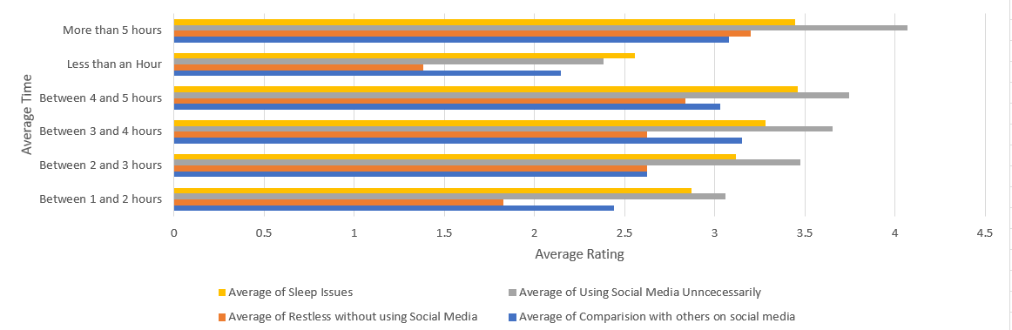
PROBLEM 1

Slide 9
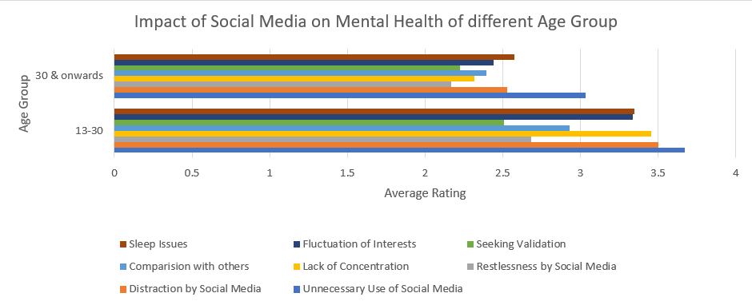
PROBLEM 2

Slide 10
CONCLUSION
Following conclusions can be drawn -
Average Time Spent on Social Media Platform on Daily basis is directly proportional to bad mental health i.e. users who spent more time on Social Media gets more distracted, less concentrated, have more doubt on himself, face more fluctuating interests etc.
Youths of Age Group 13 – 30 years are more indulged into Social Media and hence facing its drawbacks directly including bad Mental Health which isn’t good for them, for their career and for their life.

Slide 11
THANK
YOU

